Slide 1
Polling System
Haritha
Shambhi Reddy
Dhanush

Slide 2
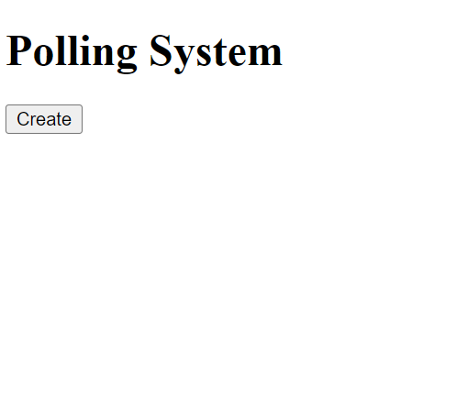
Homepage

Slide 3
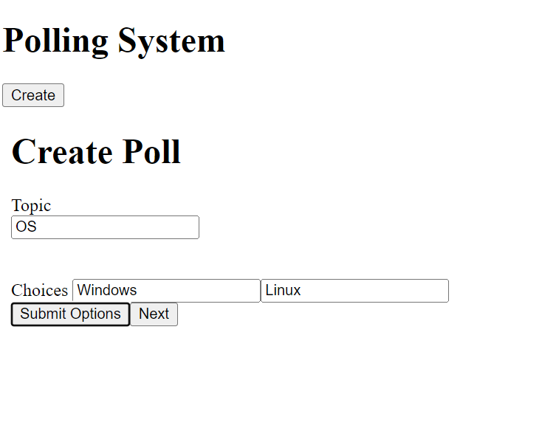
Create Poll

Slide 4
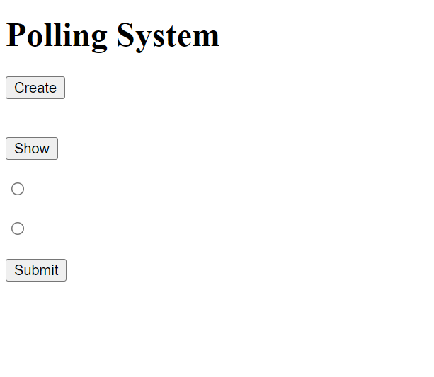
Options

Slide 5
Thank
You

